Slide 1
Modeling temperature
1. Predict temperature of LRT from Sparkling Lake and woodruff airport
2. Calculate long-term climatology from predicted temperature using heatwaveR
3. Apply climatology from modeled temperature to actual temperature data to identify heatwaves
Daily sonde temp ~ (Sparkling Lake temp + woodruff air temp + random effect for lake)
Daily sonde temp ~ (Crystal Bog temp + woodruff air temp + random effect for lake)
Weekly routines 9 am temp ~ (Sparkling Lake temp + woodruff air temp + random effect for lake)
Data availability:
Daily sonde: 2008-2011, 2013-2015, 2018, 2019
Sparkling Lake: 1989-2006, 2009-2014, 2016, 2019, no 2015 or 2018, missing half of 2008
Crystal Bog: 13 years since 2005, but no 2015 or 2018
Routines: every week, but only at 9 am, so underestimates daily temperature

Slide 2
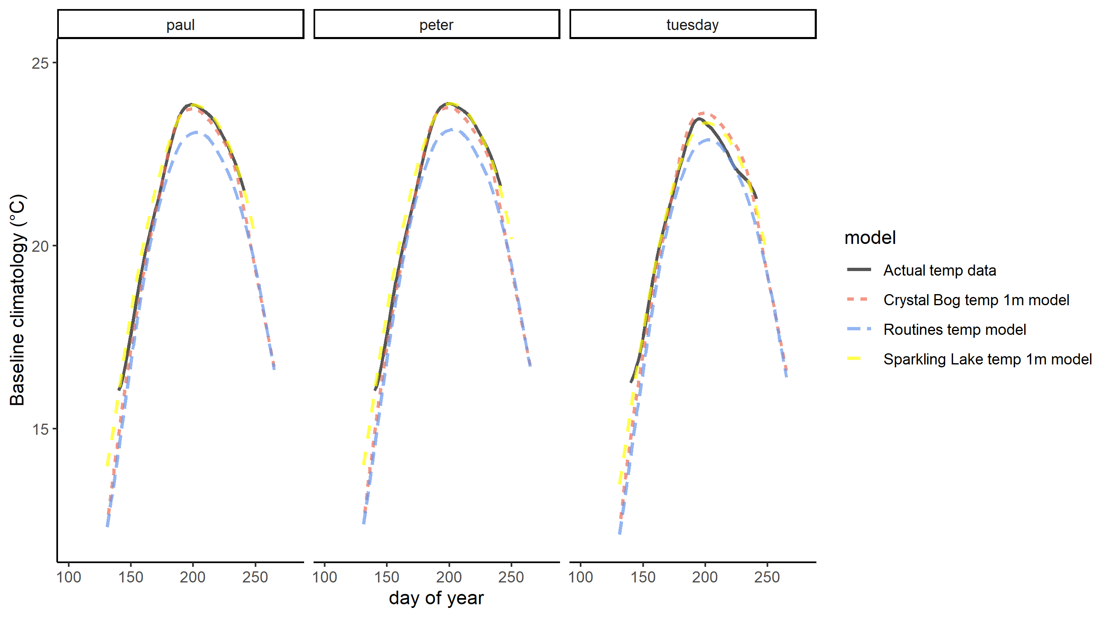
Modeling temperature
Daily sonde temp ~ (Sparkling Lake temp + woodruff air temp + random effect for lake)
Daily sonde temp ~ (Crystal Bog temp + woodruff air temp + random effect for lake)
Weekly routines 9 am temp ~ (Sparkling Lake temp + woodruff air temp + random effect for lake)

Slide 3
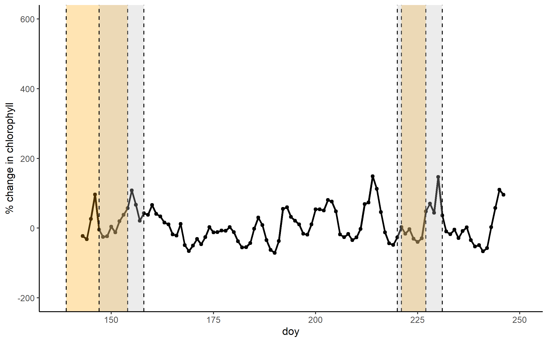
Paul 2010
heatwave
Days included in analysis
Percent change is calculated from 7-day slopes,
and we include 5 days of percent change in results
5 days of percent change included

Slide 4
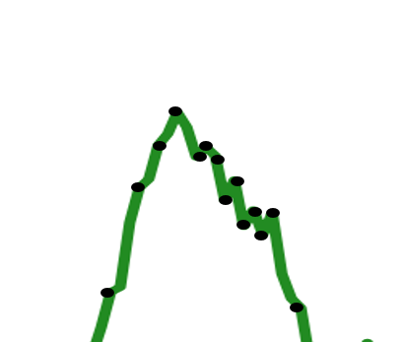
Percent Change calculation
Slope is equal to rise over run. We know the ‘run’ is the number of days, or slopeLength. We can multiply by slopeLength to get the rise, or the expected change in chlorophyll over the time period
We ignore the intercept of the line, so that the rise is equal to Yfinal – Yinitial
Percent change is equal to 100*(Yfinal – Yinitial)/Yinitial. We can divide the rise from the slope by Yinitial (baseline chlorophyll at the start of the slope) and multiply by 100 to get the percent change*
* This gives percent change where the change in chlorophyll is smoothed by the linear model, and we divide by the actual starting value of chlorophyll

Slide 5
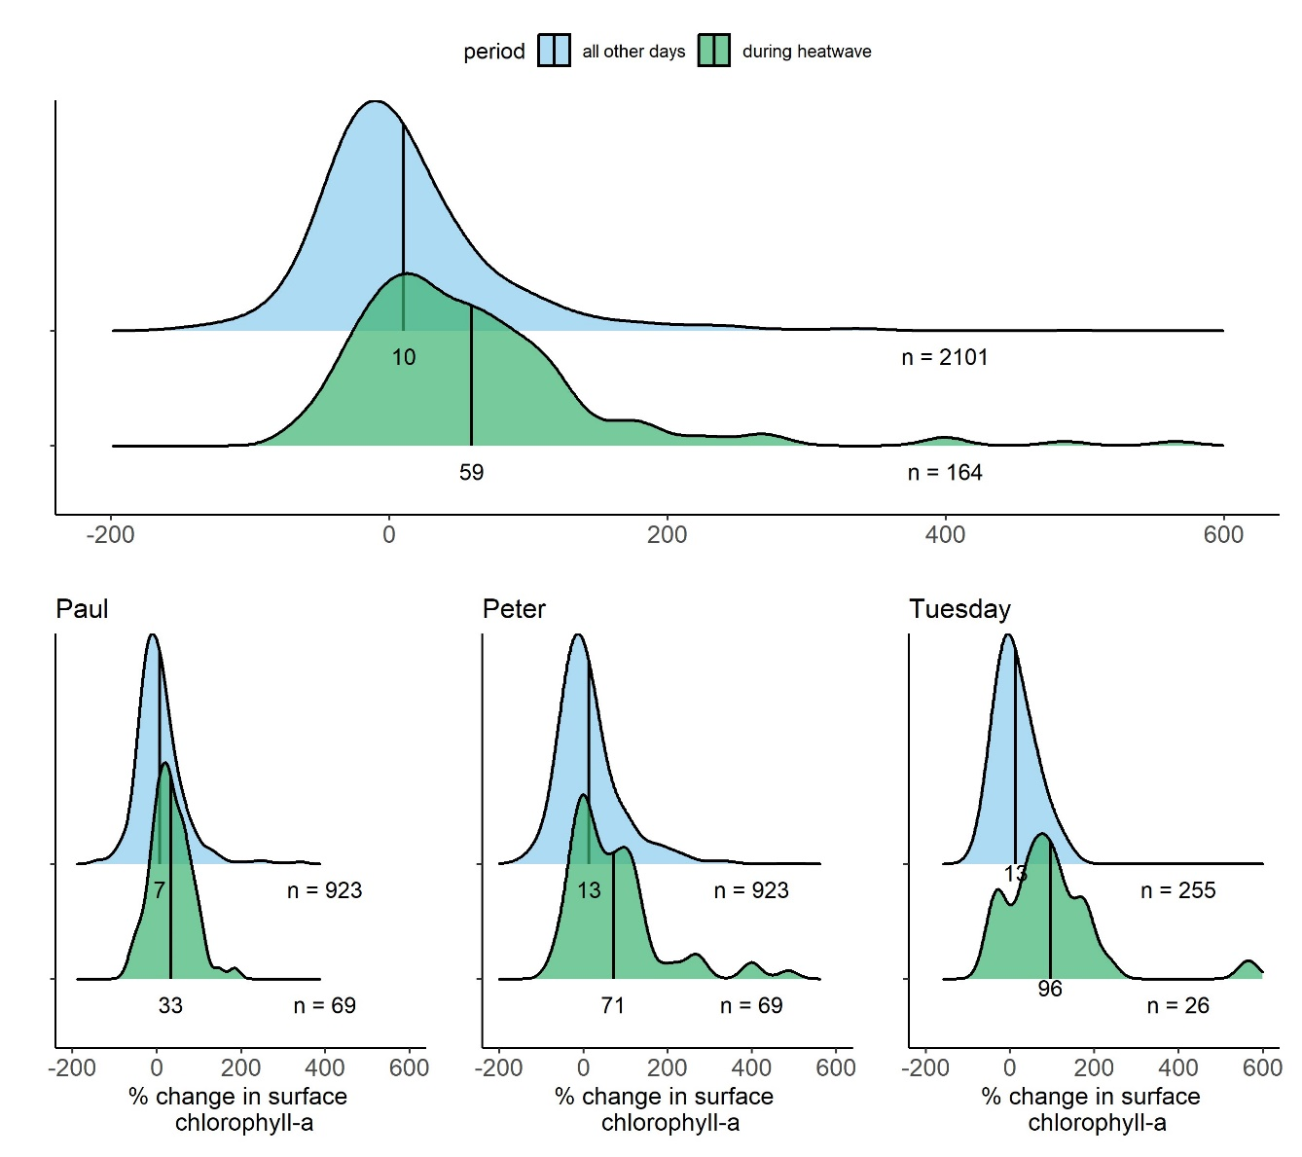
Figure 1

Slide 6
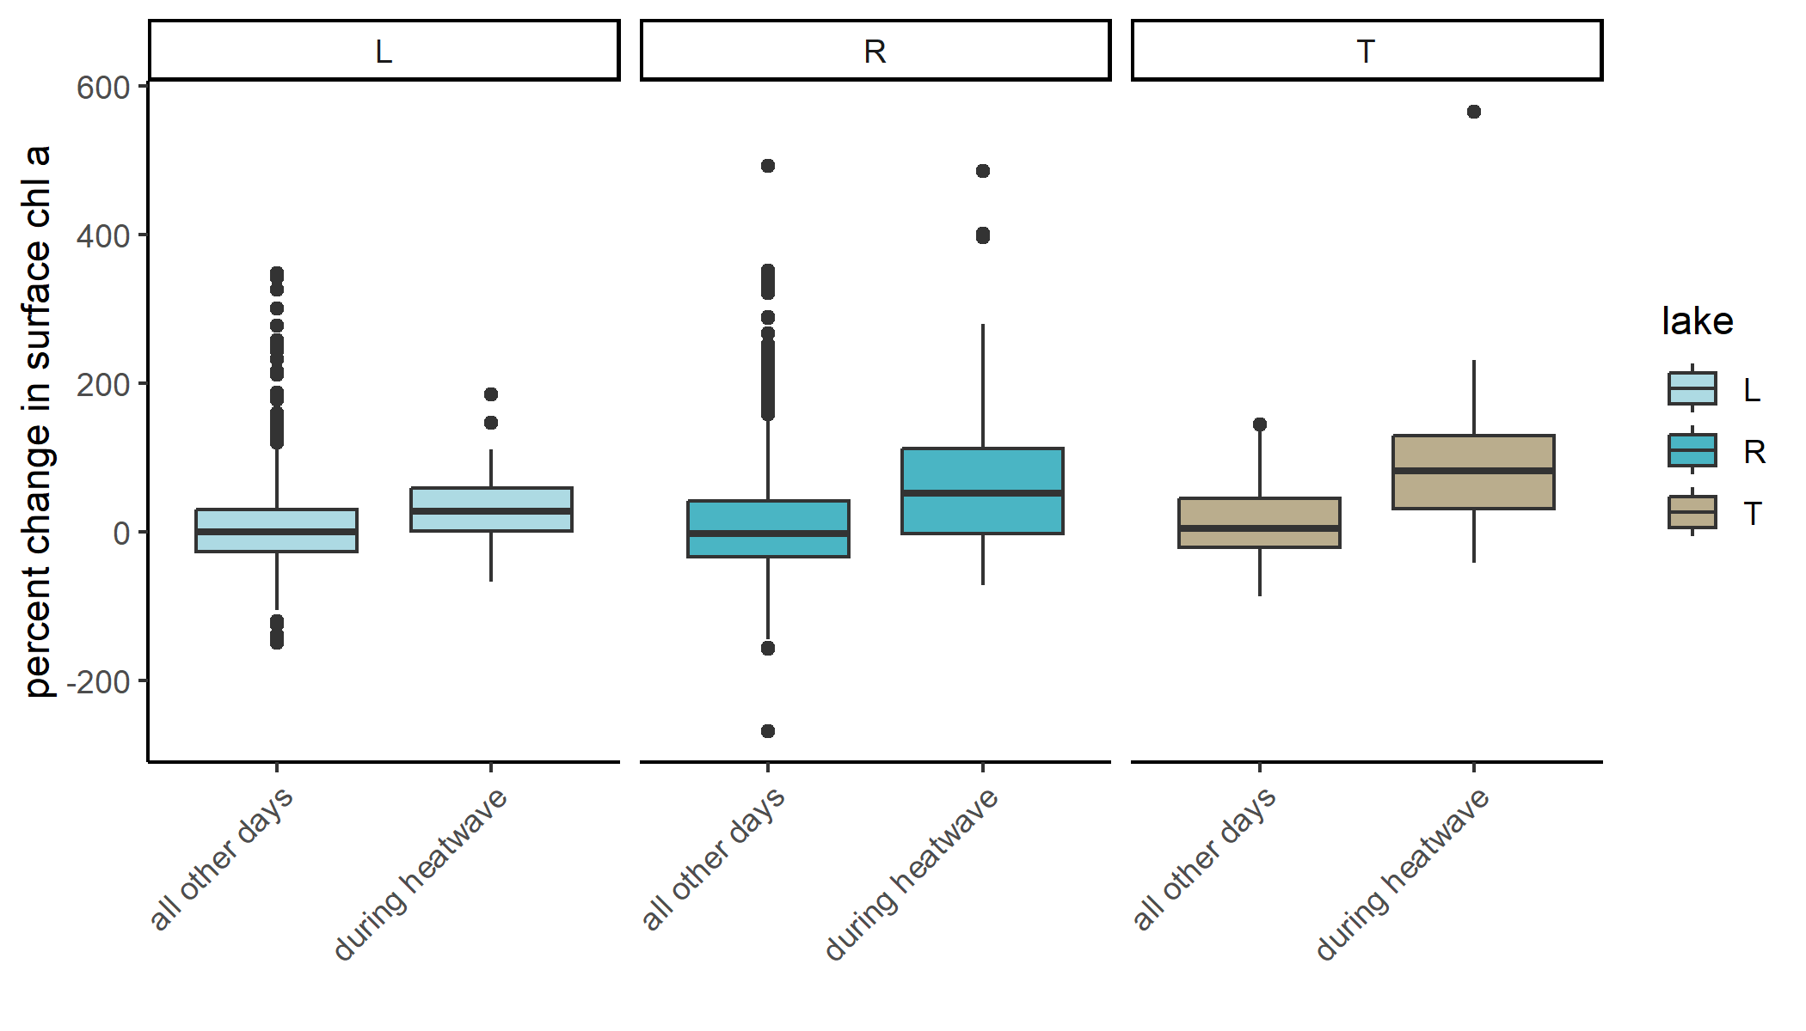
Welch’s t-test
P < 0.0001
P < 0.0001
P = 0.002
Overall across lakes: P < 0.0001

Slide 7
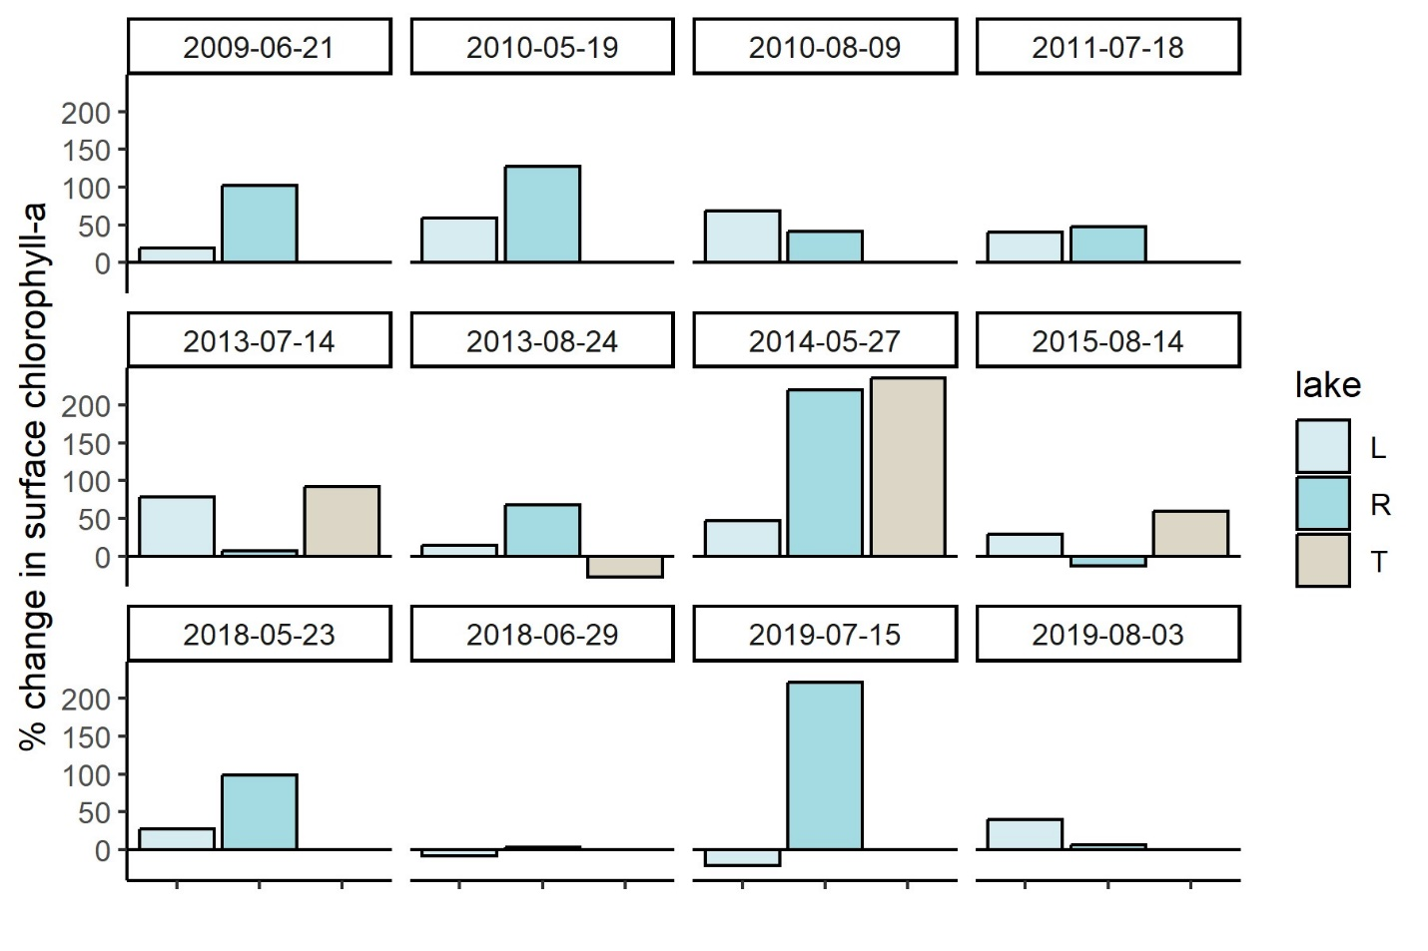
Figure 2

Slide 8
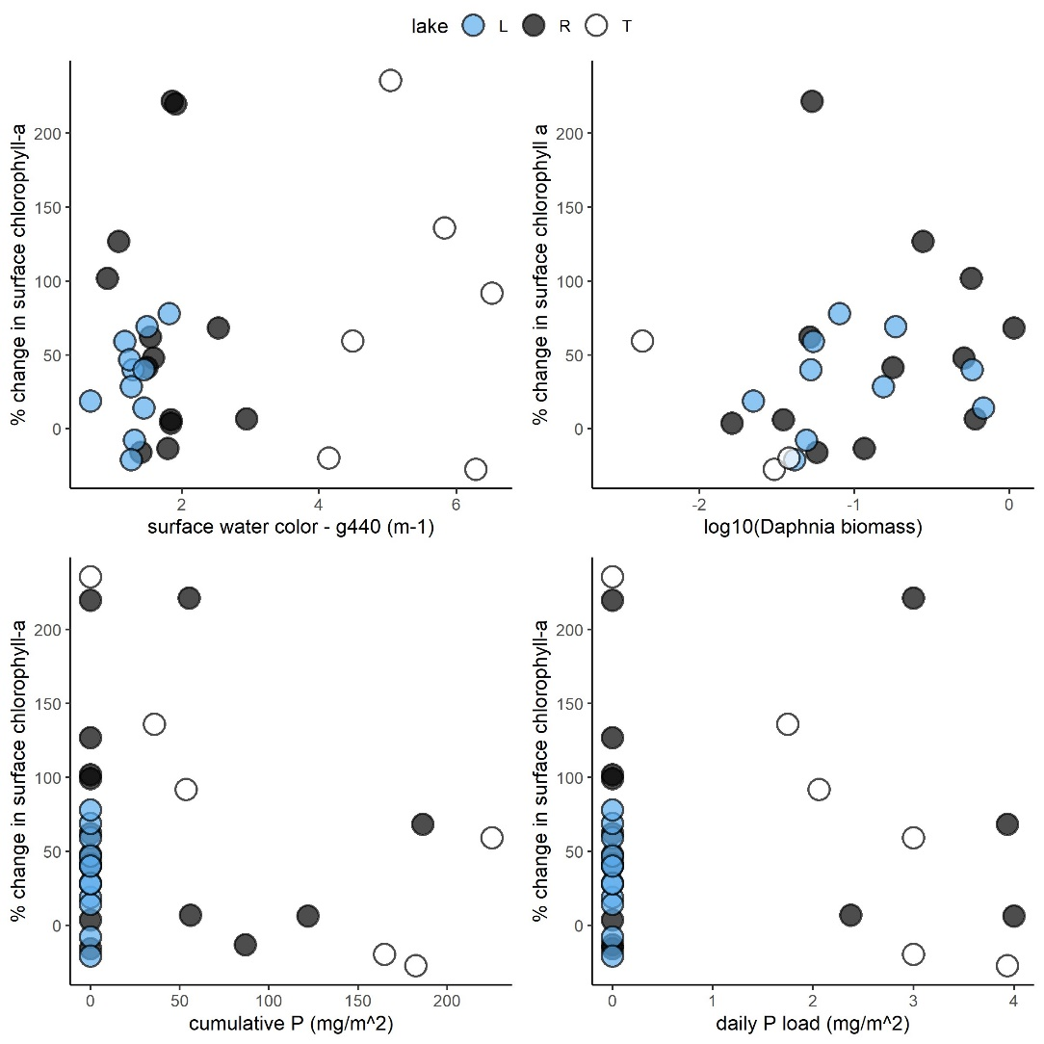
Figure 3

Slide 9
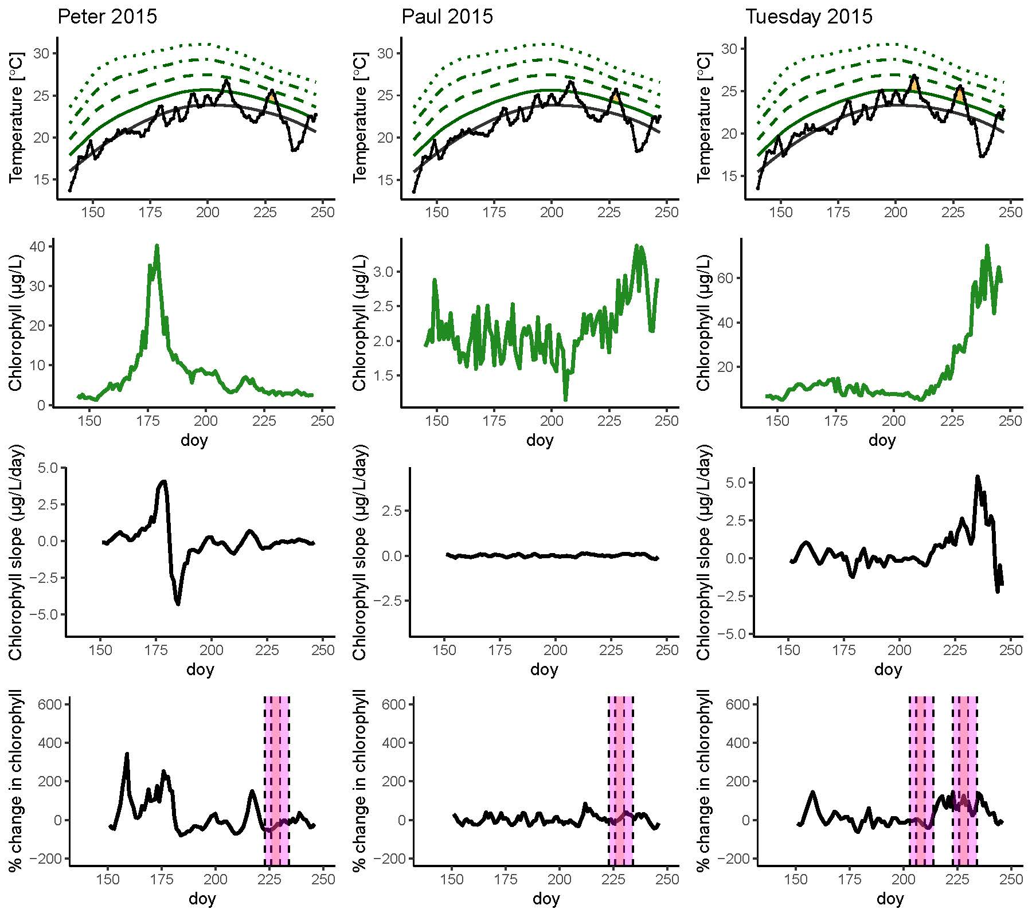
2015 Example? New figure 1?

Slide 10
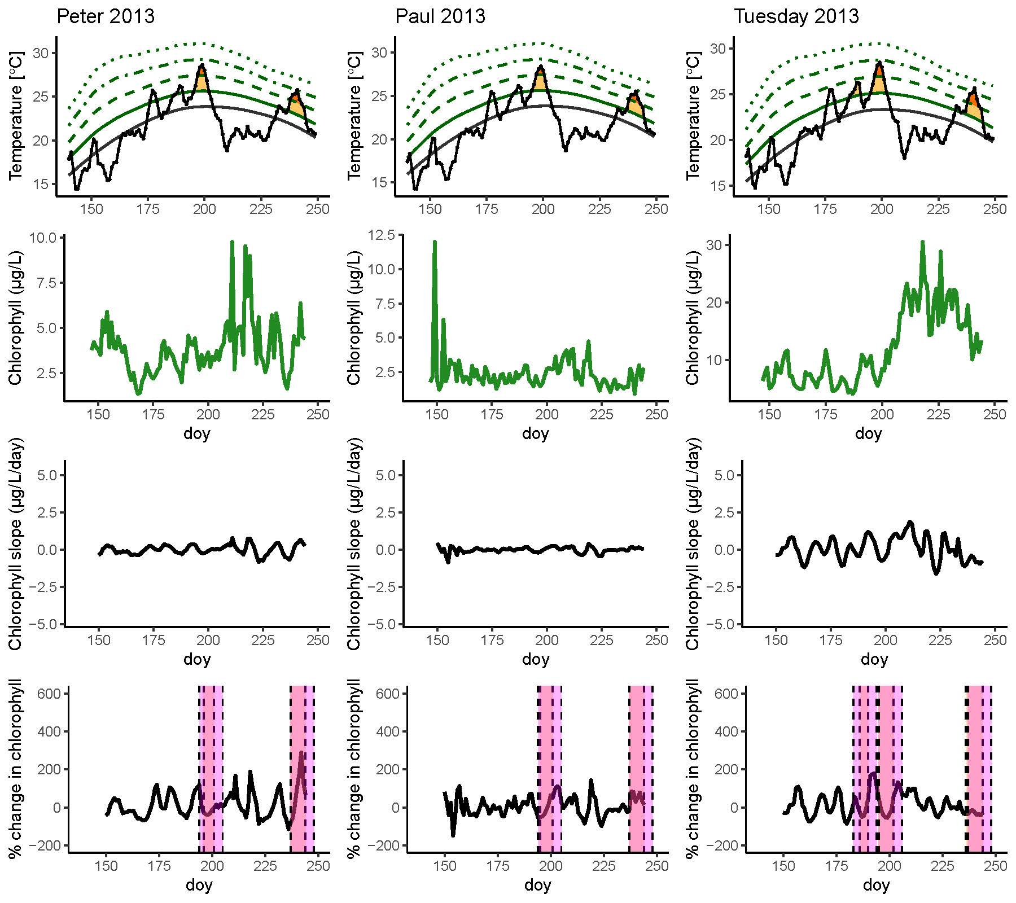
Or 2013?

Slide 11
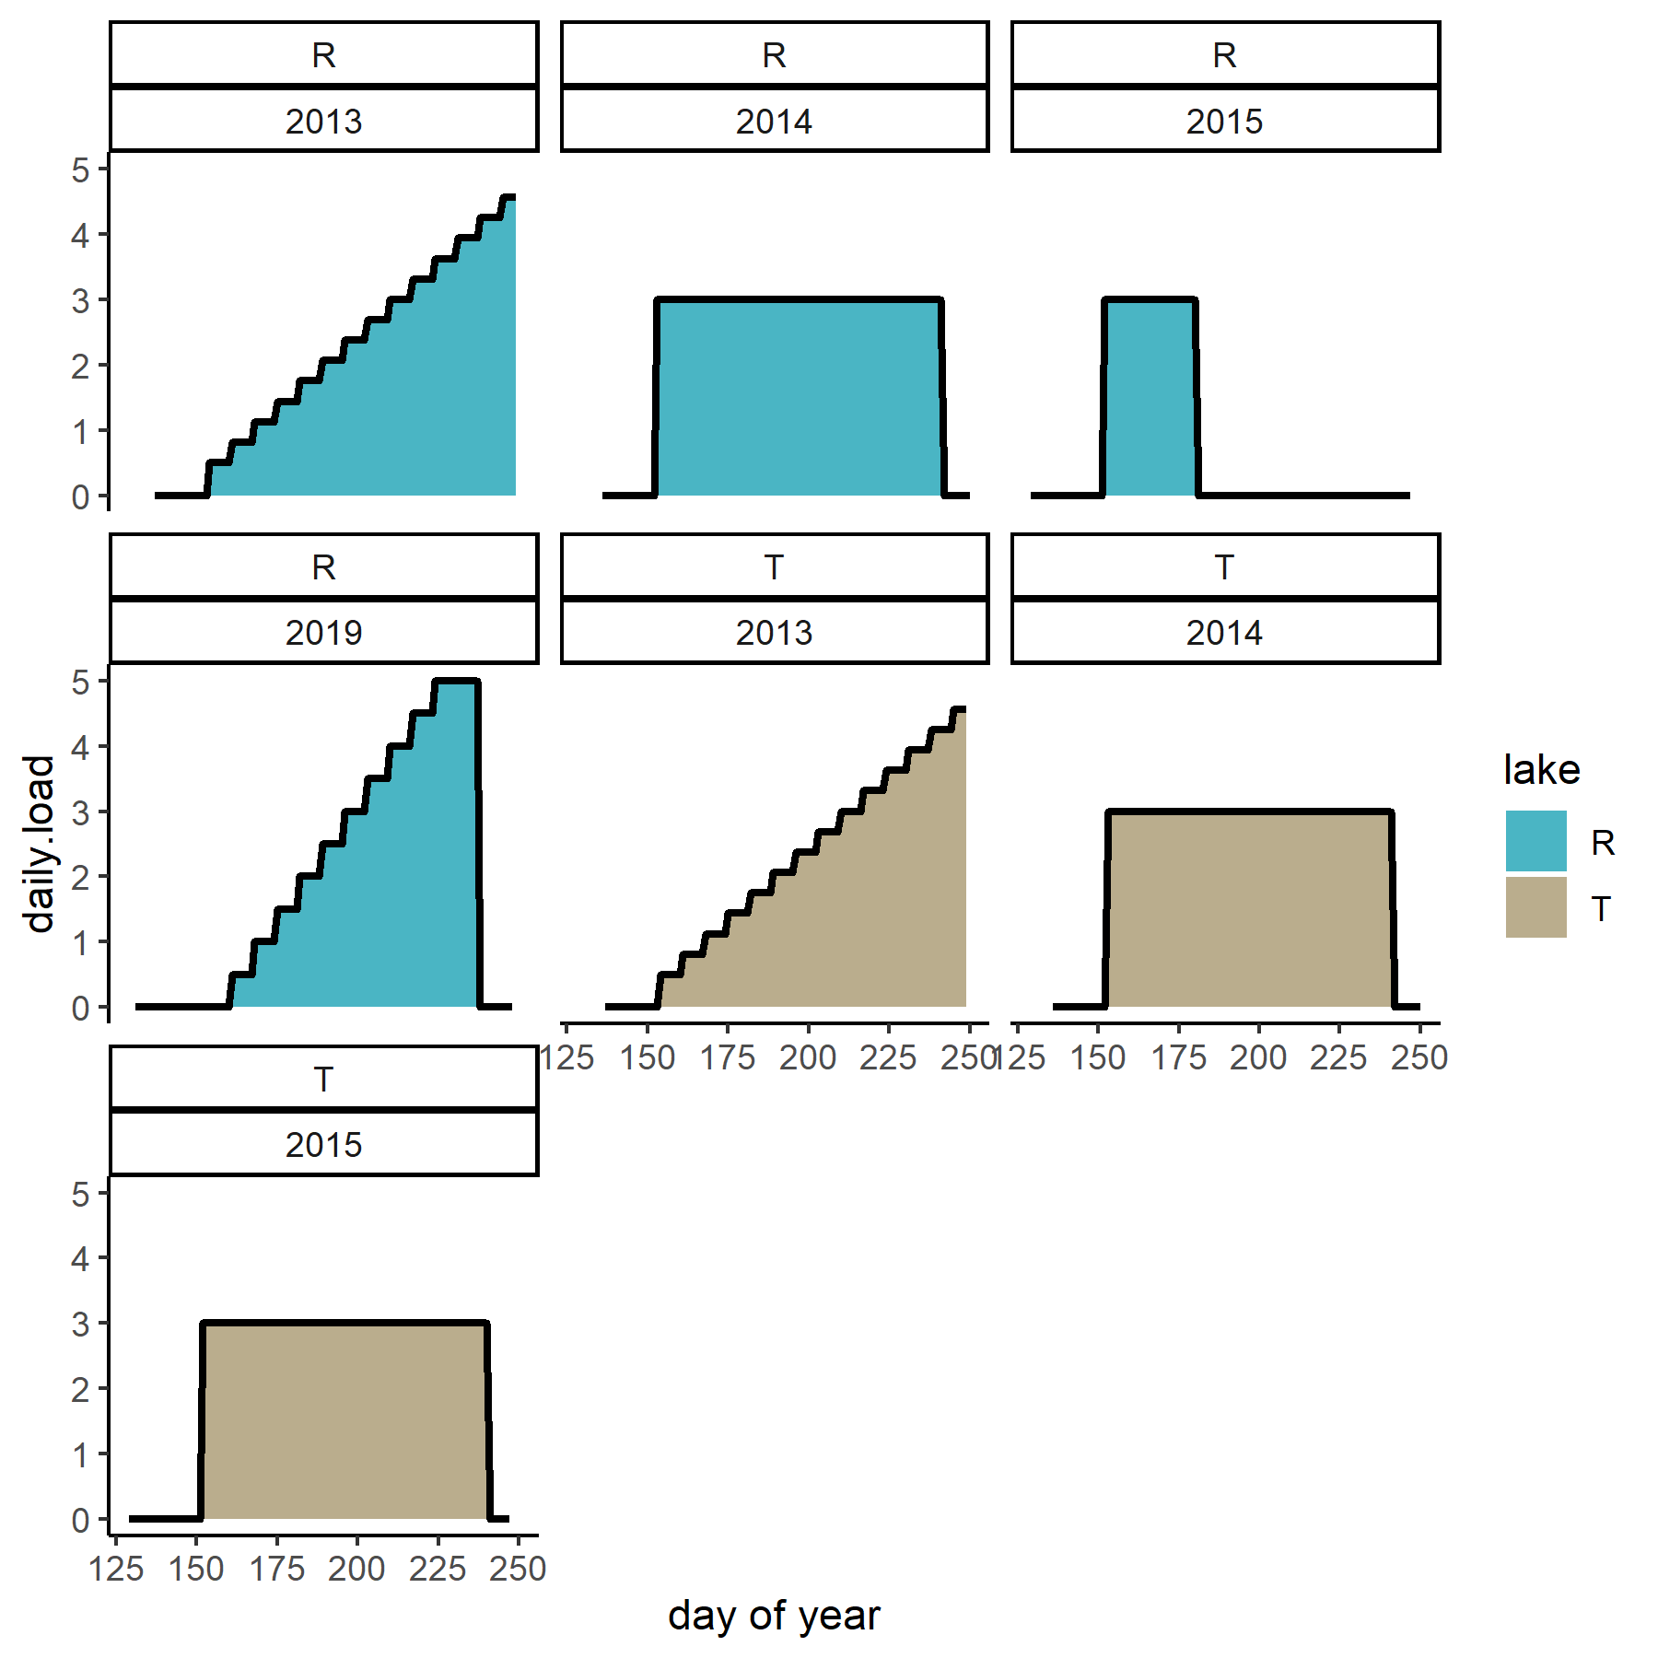
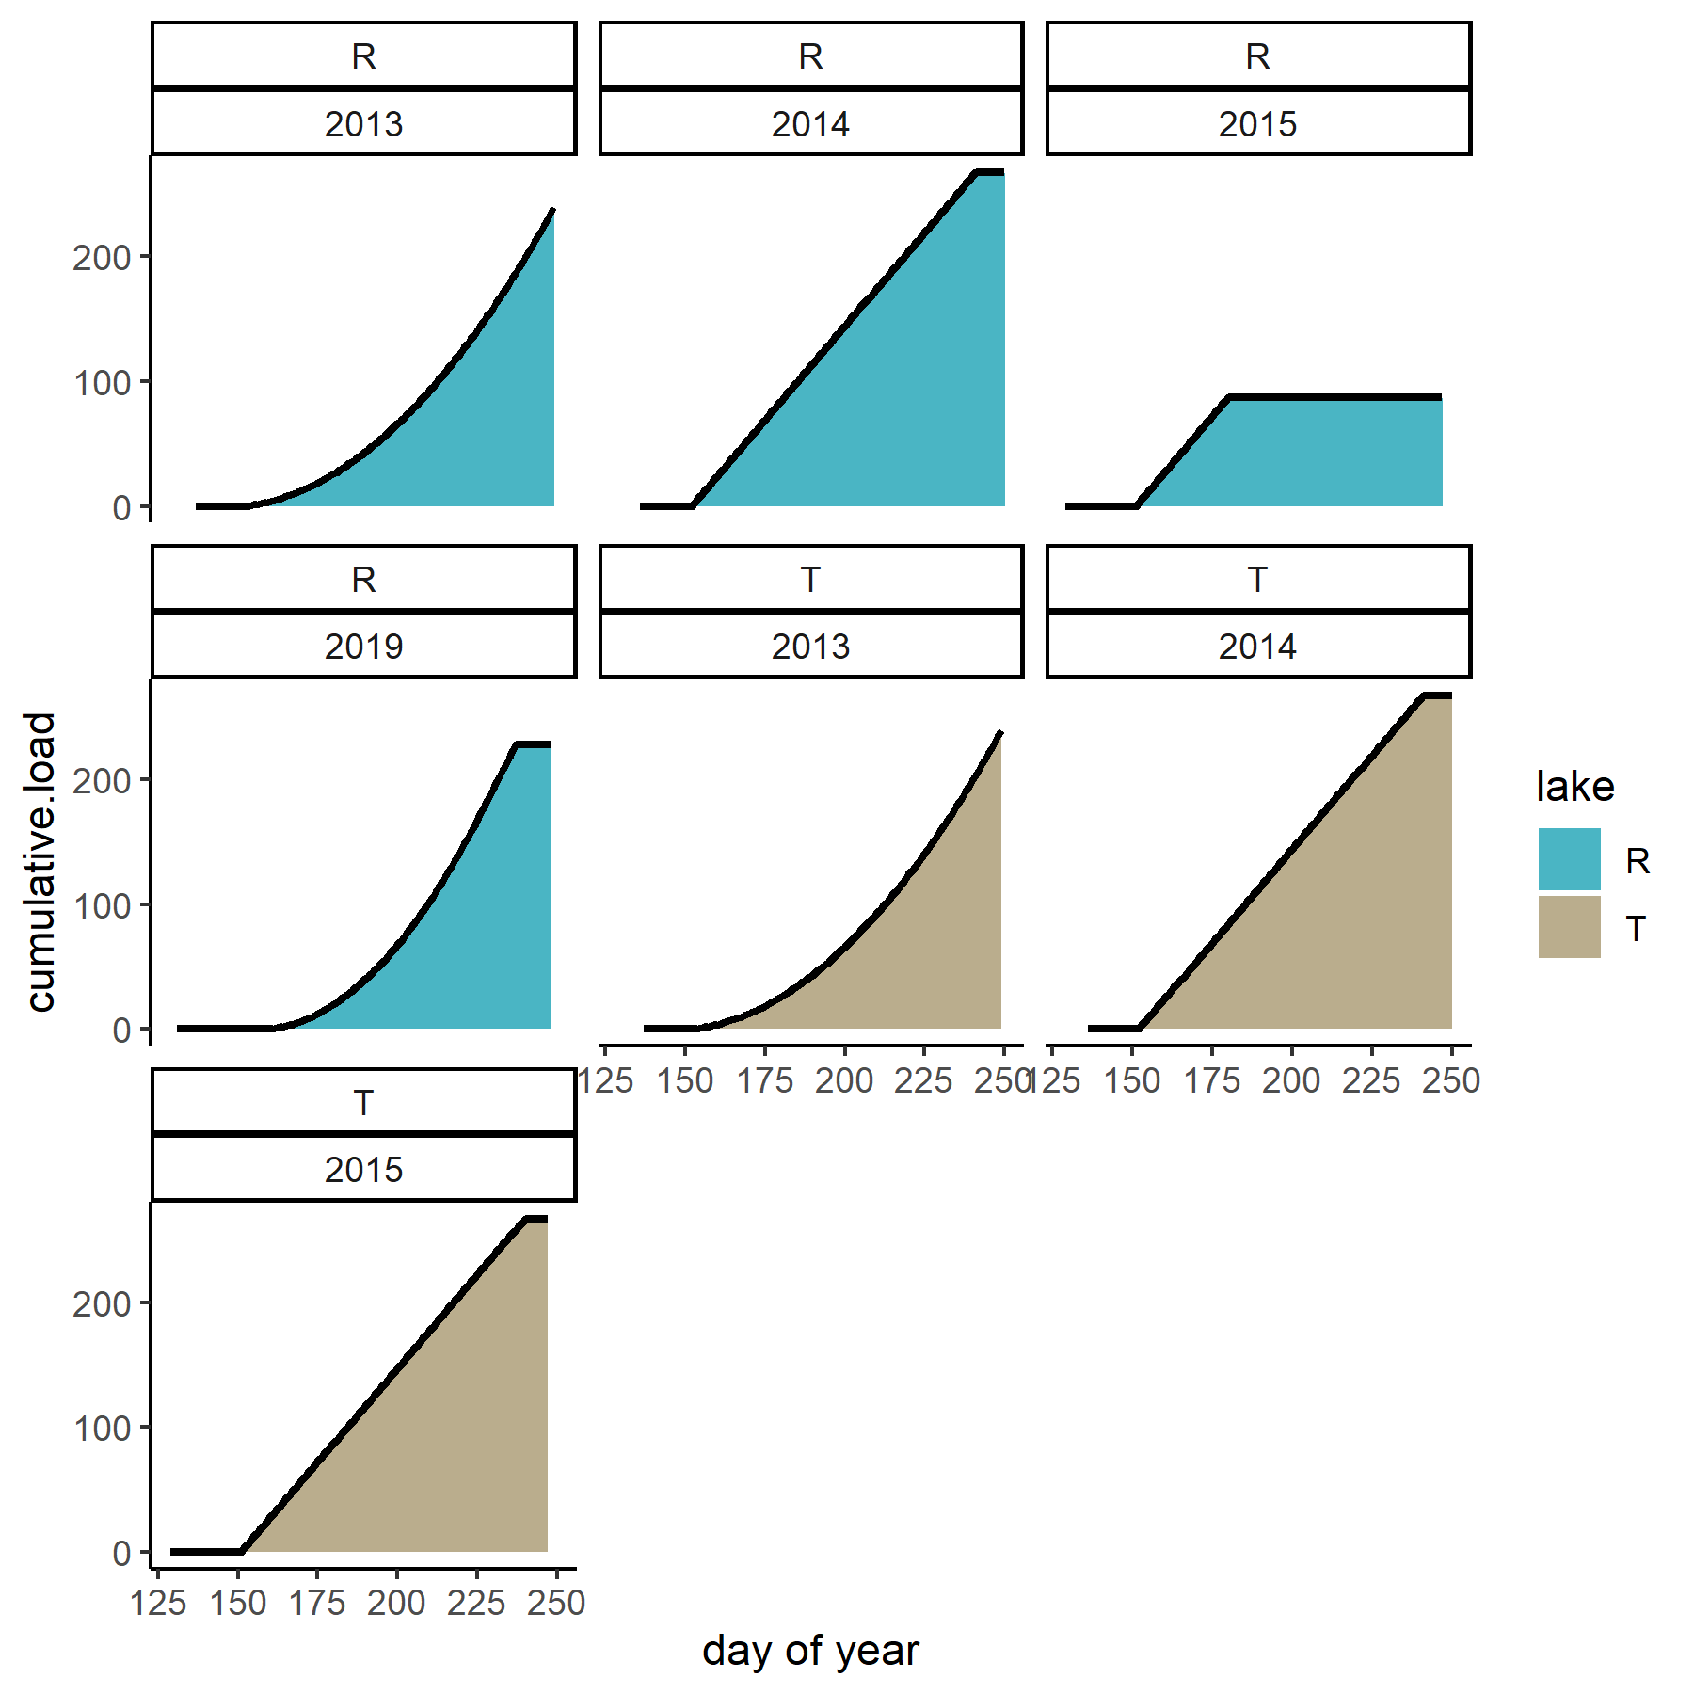
Nutrient additions

